Slide 1
CD STORES
BY TEAM NO: 7
J.INDIRA PRIYADARSINI(681252025)
M.D.V.SUDHEER(681252036)
ABHINAV RAGHAVA(681252022)
KALYAN CHAND PALAKA(681252028)

Slide 2
ABSTRACT
Aims at the computerization of the CD STORES details system.
Consists of 1 module:
Administrator
Administrator performs the Insertion, Deletion ,Updating and searching the details of Cds as per the customer requirements.

Slide 3
Problem statement:
Our project aims at the computerizing the details of all the cds in a cd shop. It also aims at making the computerized system much more user friendly and, thus, interactive. Also we aim at keeping high security as any change in the details of the cds would lead to inconvenience to the customer as well as to the administrator.

Slide 4
Scope:
It can be definitely said that the model of “CD STORES MANAGEMENT SYSTEM” is more efficient. The entire implemented system mainly demonstrates the concept of a maintaining the details of the cds and the transactions with the customers as per the administrator requirement. This project helps the administrator from avoiding the manual stress in maintaining the transaction records. There is always some scope for further development, even in an otherwise complete and comprehensive system

Slide 5
ADMINISTRATOR
adminid
logins
adminname
userid
login
adminid
password
add
delete
update
search
cid
userid
category
cname
categorised
pid
cid
products
pname
Differenciated as
companyname
totalcost
ref
pid
cuid
companyid
producttype
billno
purchases
cost
bill
avail
items
total
refno
pid
purchases
pdetails
cuid

Slide 6
Conceptual schema:
It includes detailed descriptions of the entity types, relationships and constraints.
ADMINSTRATOR TABLE:
administrator(adminid,adminname)
adminname
adminid
administrator

Slide 7
LOGIN TABLE:
Login(userid, password, adminid)
adminid
usrnid
passwrd
LOGIN

Slide 8
CATEGORY TABLE:
Category(cid,cname,userid)
usrnid
cid
cname
CATEGORY

Slide 9
PRODUCT TABLE
Product(pid,pname,cid)
pid
pname
cid
PRODUCT

Slide 10
PRODUCTTYPE:
producttype(companyid,companyname,pid, cost,avail)
compnyid
cmpnam
pid
cost
PRODUCTTYPE
avail

Slide 11
PURCHASEDETAILS:
Pdetails(cuid,refno,items,pid,total)
refno
cuid
total
pid
PDETAILS
items

Slide 12
BILL DETAILS:
bill(billno,ref,totalcost,cuid)
cuid
billno
totalcost
ref
bill

Slide 13
normalization
The primary goal of it is focusing on time dependent properties and to remove redundant information.
Different types are:
1NF
2NF
3NF

Slide 14
For ADMINISTRATOR table FD’s are:
Login(userid , password,adminid)
userid password
userid adminid

Slide 15
For CATEGORY table FD’s are:
Category(cid , cname,userid)
cid cname
cid userid

Slide 16
For PRODUCT table FD’s are:
Product(pid , cid , pname)
pid cid
pid pname

Slide 17
For PRODUCT TYPE table FD’s are:
Producttype(companyid,companyname,cost,avail,pid)
companyid avail
companyid companyname
companyid pid
companyid cost

Slide 18
For PDETAILS table FD’s are:
Pdetails(cuid,refno,pid , items ,total)
cuid pid
cuid items
cuid total
cuid refno

Slide 19
For BILL table FD’s are:
bill(billno,ref,totalcost,cuid)
billno ref
billno totalcost
billno cuid

Slide 20
Structure of tables
For ADMINISTRATOR table:
Name Key constraints Type
------------------------------- -------------------- ----------------------
ADMINID PRIMARY KEY VARCHAR2(20)
ADMINNAME VARCHAR2(20)

Slide 21
Structure of tables
For LOGIN table:
Name Key constraints Type
------------------------------- -------------------- ----------------------
USERID PRIMARY KEY VARCHAR2(20)
PASSWORD VARCHAR2(20)
ADMINID FOREIGNKEY VARCHAR2(20)

Slide 22
For CATEGORY table:
Name Key constraints Type
------------------------------- ---------------- ----------------------
CID PRIMARY KEY NUMBER(20)
CNAME VARCHAR2(20)
USERID FOREIGNKEY VARCHAR2(20)

Slide 23
For PRODUCT table:
Name Key constraints Type
------------------------------- ---------------- ----------------------
PID PRIMARY KEY NUMBER(20)
PNAME VARCHAR2(20)
CID FOREIGN KEY NUMBER(20)

Slide 24
For PRODUCTTYPE table :
Name Key constraints Type
------------------------------- ---------------- ----------------------
COMPANYID PRIMARY KEY NUMBER(20)
COMPANYNAME VARCHAR2(20)
AVAIL NUMBER(10)
COST NUMBER(10)
PID FOREIGN KEY NUMBER(20)

Slide 25
For PDETAILS table:
Name Key constraints Type
------------------------------- ---------------- ----------------------
CUID PRIMARYKEY NUMBER(10)
ITEMS NUMBER(10)
PID FOREIGN KEY NUMBER(10)
TOTAL NUMBER(10)
REFNO NUMBER(20)

Slide 26
For BILL table:
Name Key constraints Type
---------------------------- ---------------- ----------------------
BILLNO PRIMARY KEY NUMBER(10)
REF NUMBER(10)
TOTALCOST NUMBER(10)
CUID FOREIGN KEY NUMBER(20)

Slide 27
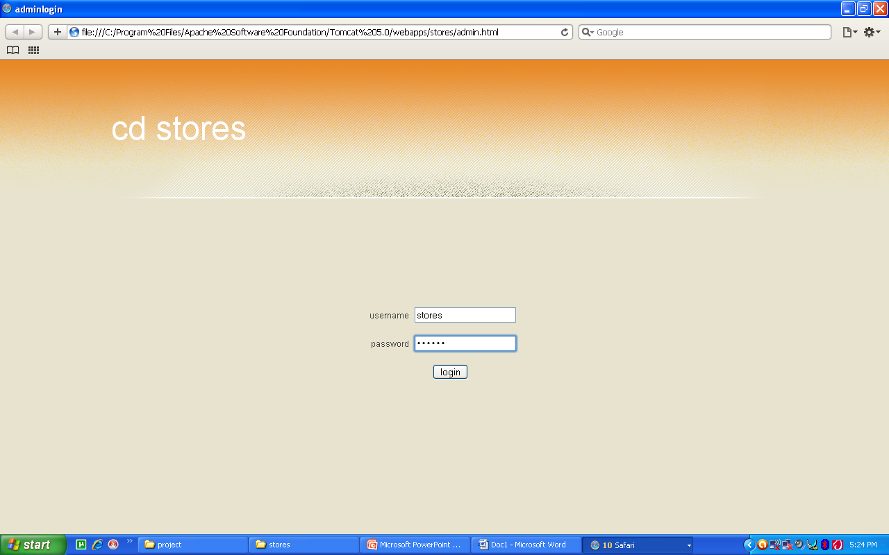
LOGIN PAGE:

Slide 28
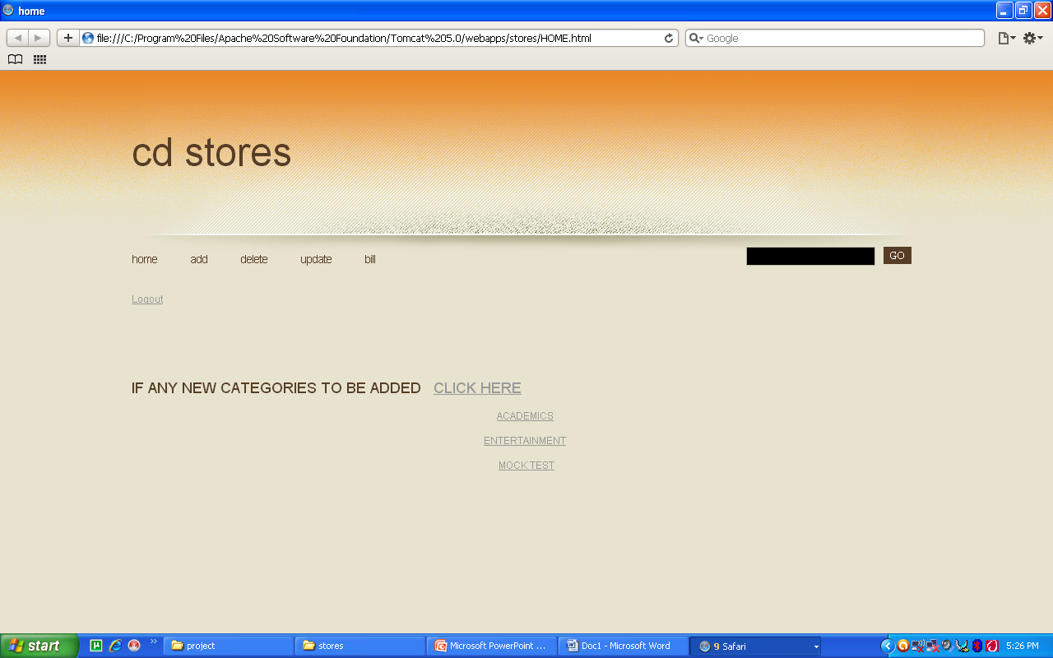
HOME PAGE:

Slide 29
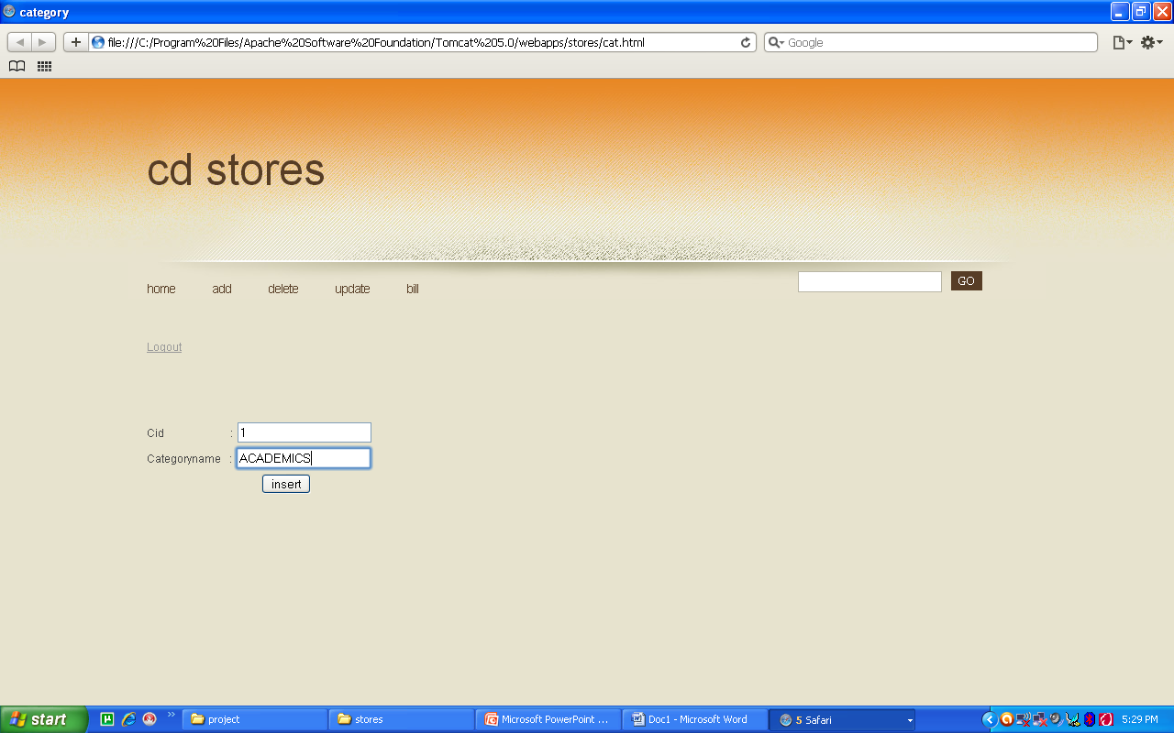
INSERTION CATEGORY:

Slide 30
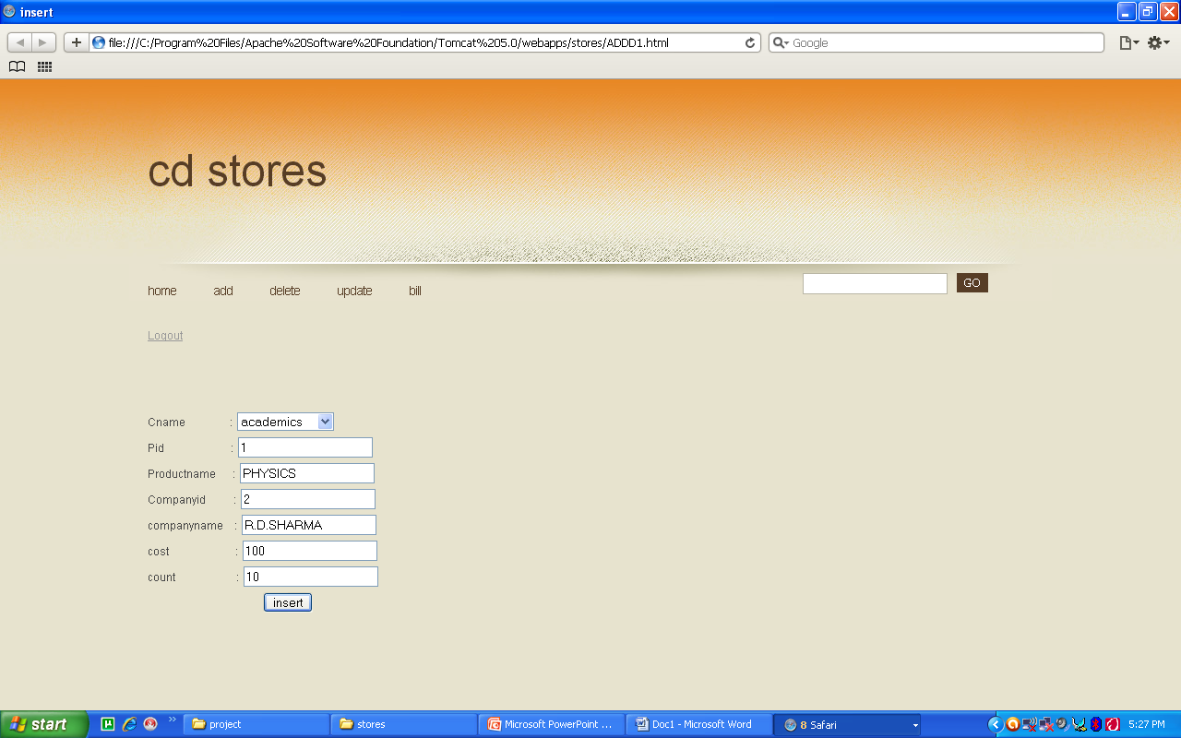
INSERTION:

Slide 31
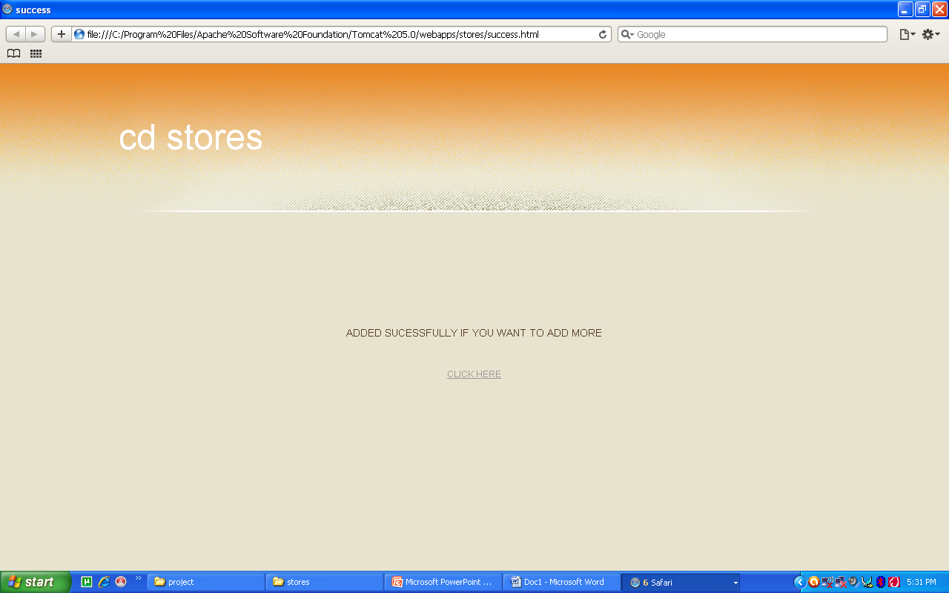
SUCCESS:

Slide 32
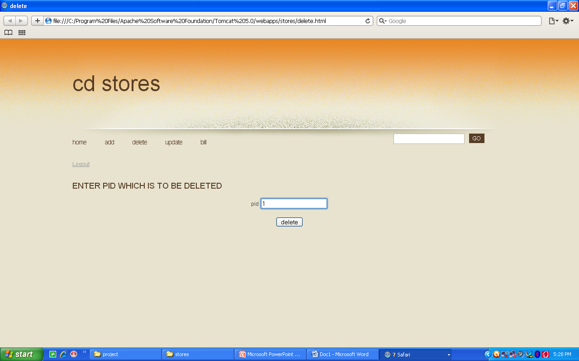
DELETION:

Slide 33
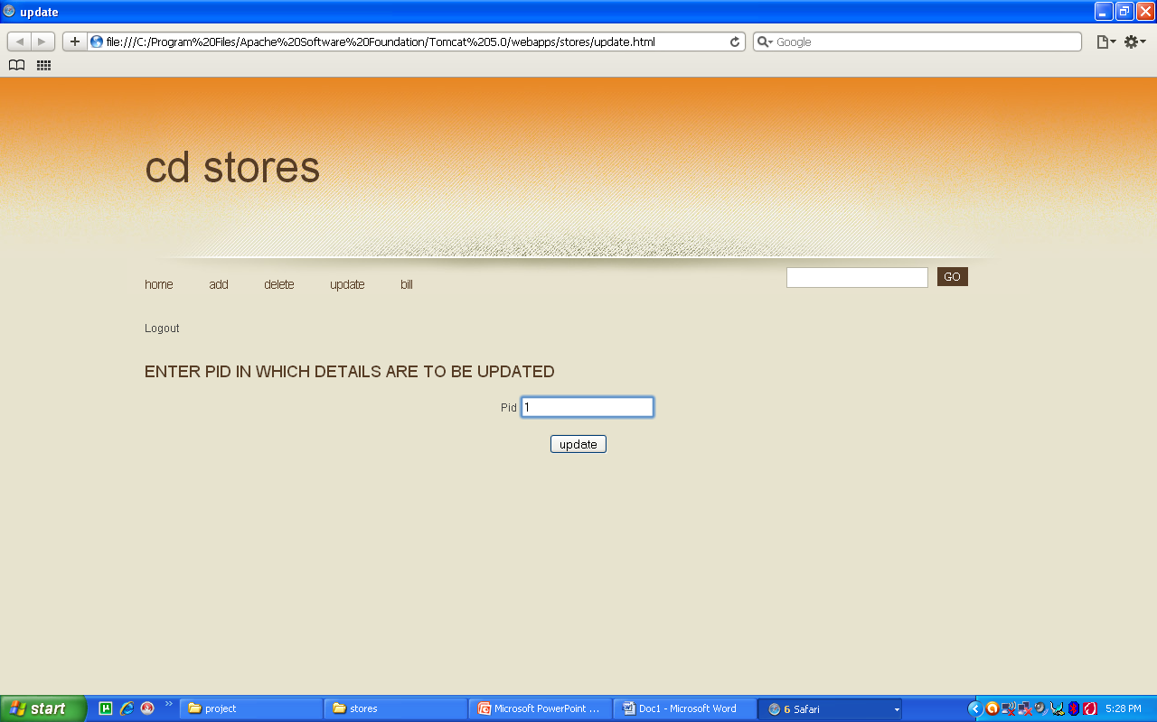
UPDATE:

Slide 34
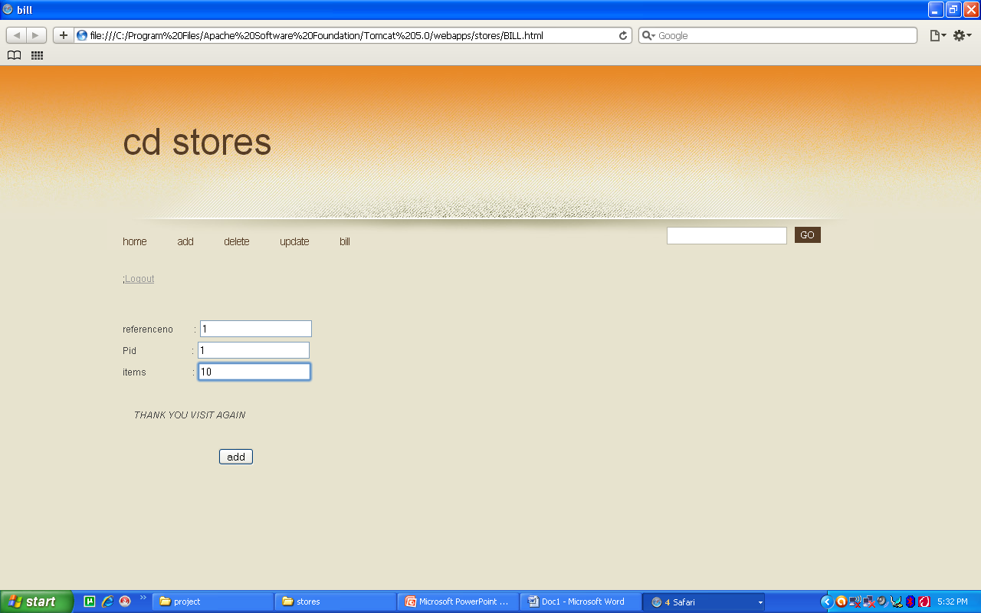
BILL:

Slide 35
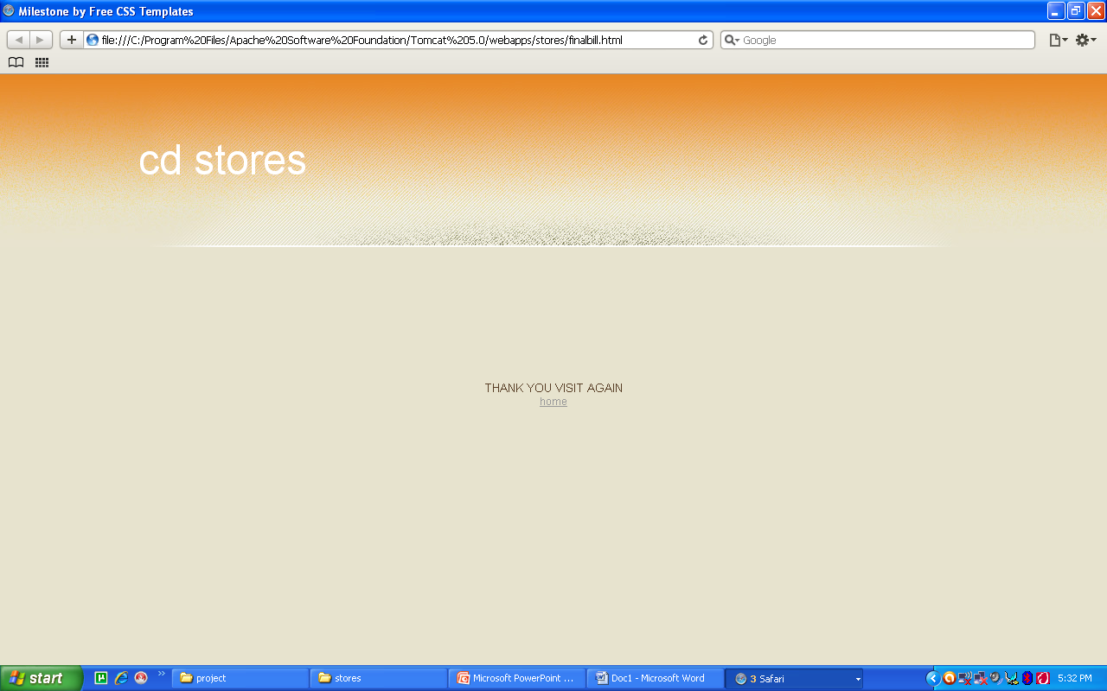

Slide 36
conclusion
By using this software the time taken for the customer to get the details of the cd will be less.
This software makes it easy for the Administrator to maintain an efficient database of all the cds available in his shop, thus making his billing system ideal.

Slide 37
References
An Introduction to Database Systems by C.J.Date
Database Programming with JDBC and Java by George Reese (O'Reilly)
Database Management Systems by A.K.Majumdar & P.Bhattacharya

Slide 38
THANK YOU

